Slide 1


Scale Up Video Understanding with Deep Learning
May 30, 2016
Chuang Gan
Tsinghua University

Slide 2
Video capturing devices are more affordable and
portable than ever.
64% of American adults own a smartphone
St. Peter’s square, Vatican

Slide 3
People also love to share their videos!
300 hours of new YouTube
video every minute

Slide 4
How to organize this
large amount of
consumer videos?

Slide 5
Using metadata
Titles
Description
Comments

Slide 6
Using metadata
Description
Comments
Could be missing or irrelevant

Slide 7
My focus:
Understanding human activities and
high-level events from unconstrained
consumer videos.

Slide 8
My effort towards video understanding

Slide 9
This is a
birthday Party
event

Slide 10
Multimedia Event Detection (MED)
IJCV’ 15, CVPR’15, AAAI’15

Slide 11
Multimedia Event Detection (MED)
IJCV’ 15, CVPR’15, AAAI’15
Third video snippet is
key evidence (blowing candle)

Slide 12
Multimedia Event Detection (MED)
AAAI’ 15, CVPR’15, IJCV’15
Multimedia Event
Recounting (MER)
CVPR’15, CVPR’16 submission

Slide 13
Multimedia Event Detection (MED)
AAAI’ 15 CVPR’15 IJCV’15
Multimedia Event
Recounting (MER)
CVPR’15, ICCV’15 submission
Woman hugs girl.
Girl sings a song.
Girl blows candles.

Slide 14
Multimedia Event Detection (MED)
IJCV’ 15, CVPR’15, AAAI’15
Multimedia Event
Recounting (MER)
CVPR’15, CVPR’16 submission
Video Transaction
ICCV’15, AAAI’16 submission

Slide 15
DevNet: A Deep Event Network for
Multimedia Event Detection and Evidence Recounting
CVPR 2015

Slide 16
Outline
Introduction
Approach
Experiment Results
Further Work

Slide 17
Outline
Introduction
Approach
Experiment Results
Further work

Slide 18
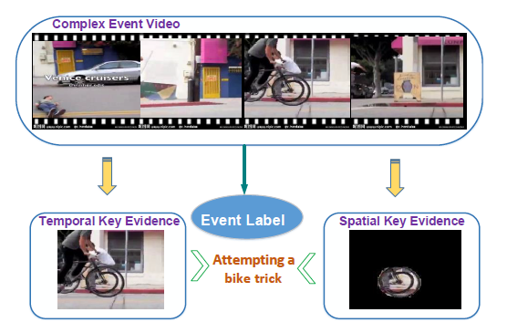
Problem Statement
  Given a video for testing, we not only provides an event label but also spatial-temporal key evidences that lead to the decision.

Slide 19
Challenge
  We only have video level labels, while the key evidences usually take place at the frame levels.
  The cost of collection and annotation of spatial-temporal key evidences is generally extremely high.
  Different video sequences of the same event may have dramatic variations. We can hardly utilize the rigid templates or rules to localize the key evidences.

Slide 20
Outline
Introduction
Approach
Experiment Results
Further Work

Slide 21
Event detection and recounting Framework
  DevNet training: pre-training and fine-tuning
  Feature extraction: forward pass the DevNet (Event Detection)
  Spatial-temporal saliency map: backward pass the DevNet (Evidence Recounting)

Slide 22
DevNet training Framework
  Pre-training: initial the parameters using the large-scale ImageNet data.
  Fine-tuning: using MED videos to adjust the parameters for the video event detection task.
  Ross Girshick et al. “Rich feature hierarchies for accurate object detection and semantic segmentation.” CVPR, 2014.

Slide 23
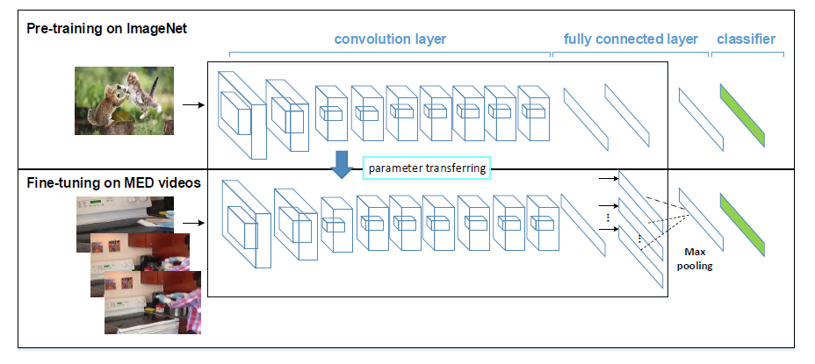
DevNet pre-training
  Architecture: conv64-conv192-conv384-conv384-conv384-conv384-conv384-conv384-conv384-full4096-full4096-full1000. On ILSVRC2014 validation set, the network achieves the top-1/top-5 classification error of 29.7% / 10.5%.

Slide 24
DevNet fine-tuning
  a) Input: Single image -> multiple key frames

Slide 25
DevNet fine-tuning
  b) Remove the last fully connected layer.

Slide 26
DevNet fine-tuning
  c) A cross-frame max pooling layer is added between the last fully connected layer and the classifier layer to aggregate the video-level representation.

Slide 27
DevNet fine-tuning
  d) Replace the classifier layer 1000-way softmax to
  20-class independent multiple logistic regression.

Slide 28
Event detection framework
  Extracting key frames.
  Extracting features: we use the features of the last
  fully-connected layer after max-pooling for video representation. We then normalize the features to make the l2 norm equal to 1.
  Training event classifier: SVM and kernel ridge regression (KR) with chi2 kernel are used.

Slide 29
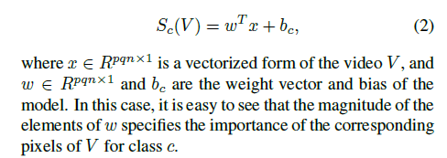
Spatial-temporal saliency map
  Considering a simple case in which the detection score of event class c is linear with respect to the video pixels.
  Karen Simonyan et al. “Deep Inside Convolutional Networks: Visualising Image Classification Models and Saliency Maps” ICLR workshop 2014.

Slide 30

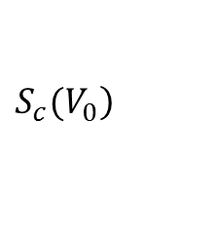

Spatial-temporal saliency map
  In the case of a deep CNN, however, the class score is a highly nonlinear function of video pixels.
  However, we can also get the derivative of with respect to each pixel $V_{0}$ by backpropagation:
  The magnitude of the derivative indicates which pixels within the video need to be changed the least to affect the class score the most.
  We can expect that such pixels are the spatial-temporal key evidences to detect this event.
$$\left.S_{c}(V_{0}\right)$$

Slide 31
Evidence recounting framework
  Extracting key frames.
  Spatial-temporal saliency map: given the event label we are interested in, we perform a backward pass based on the DevNet model to assign to each pixel in the testing video a
  saliency score.
  Selecting informative key frames: for each key frame, we compute the average of the saliency scores of all pixels and use it as the key-frame level saliency score.
  Segmenting discriminative regions: we use the spatial saliency maps of the selected key frames for initialization and apply graph-cut to segment the discriminative regions as spatial key evidences

Slide 32
Outline
Introduction
Approach
Experiment Results
Further work

Slide 33
  Event Detection Results on MED14 dataset
 | fc7 (CNNs) | fc7 (DevNet) | fusion
SVM | 0.2996 | 0.3089 | 33.74
KR | 0.3041 | 0.3198

Slide 34
  Event Detection Results on MED14 dataset
  Practical trick and ensemble approach can improve the results significantly. (multi-scale, flipping, average pooling, different layers ensemble, fisher vector encoding.)
 | fc7 (CNNs) | fc7 (DevNet) | fusion
SVM | 0.2996 | 0.3089 | 33.74
KR | 0.3041 | 0.3198

Slide 35
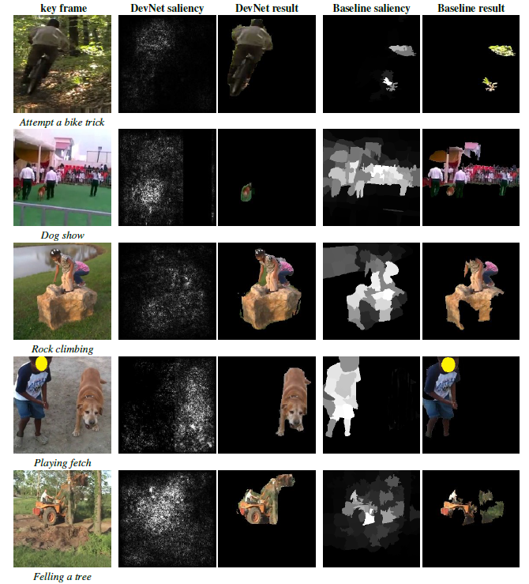
  Spatial evidence recounting compared results

Slide 36
Webly-supervised Video Recognition
CVPR 2016

Slide 37
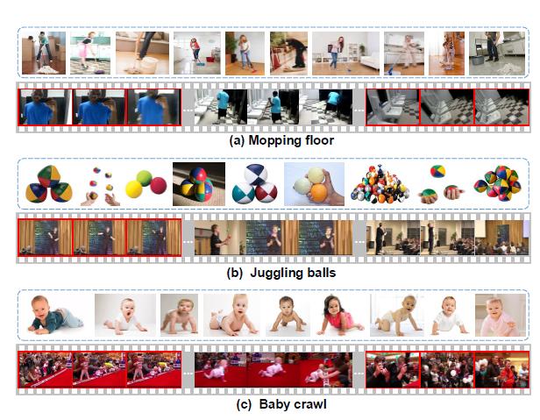
Webly-supervised Video Recognition
Motivation
  Given the maturity of commercial visual search engines (e.g. Google, Bing, YouTube), Web data may be the next important data to scale up visual recognition.
  The top ranked images or videos are usually highly correlated to the query, but are noise.
Gan et. al. You Lead, We Exceed: Labor-Free Video Concept Learning
by Jointly Exploiting Web Videos and Images. (CVPR 2016 spotlight oral)
Notes:
随着搜索引擎的逐渐成熟， 网络数据将可能成为下一代机器学习可以依赖的训练样本，来替代人工标机的样本。尽管很有希望，但网络数据（无论是图片还是视频）仍然很noise，直接使用效果不会好。这篇paper 提出了如何有效的利用网络图片和视频的一些特点来协同去除noise的数据，来实现Webly-supervised video recognition。

Slide 38
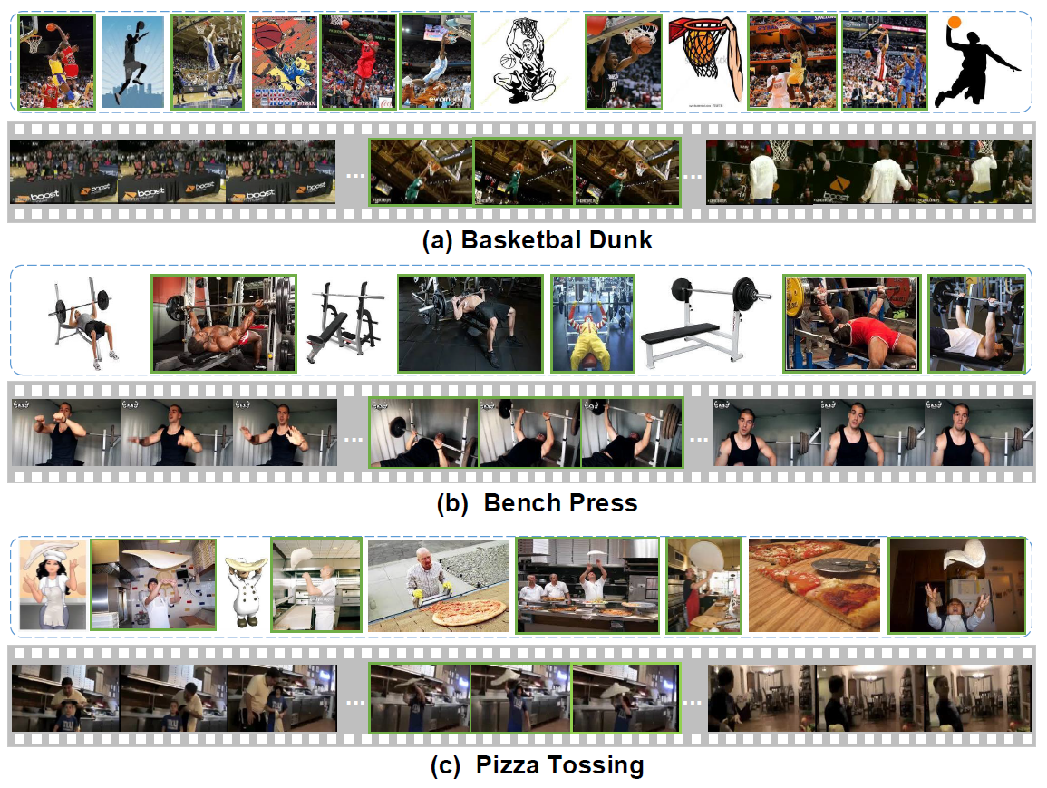
Webly-supervised Video Recognition
Observations
The relevant images and frames typically appear in both domains with similar appearances, while the irrelevant images and videos have their own distinctiveness!
Notes:
Web images （上） 和 Web video frames（下） 跟query 相关的visually 很像，但不相关的部分（noise）却不太相同。Web image 的noise 通常是一些剪切画或者白色背景的图，这些一般不会出现在video 那些不相关的frame中。

Slide 39
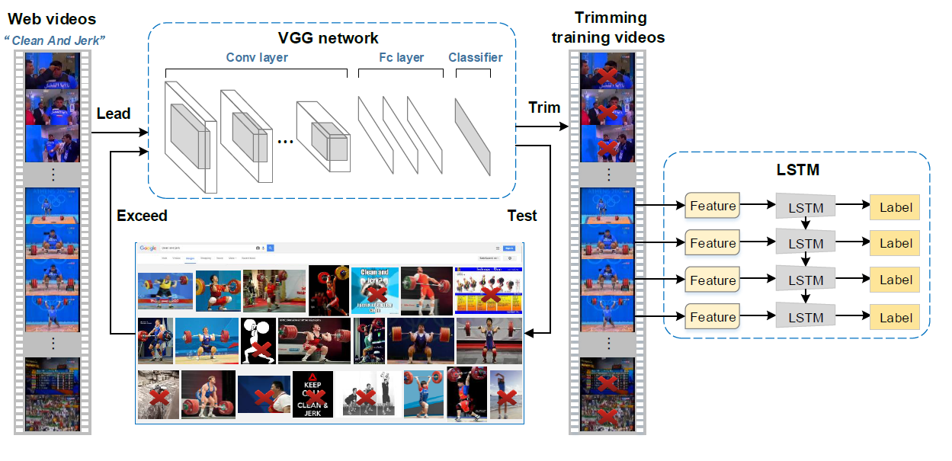
Webly-supervised Video Recognition
Framework
Notes:
整个过程分为三个步骤。（1）先用raw web video frames train 一个Lead network。 （2）再用这个train 好的lead network 去筛选高质量的网络图像。这些筛选好的图像将会用来update 之前的model。这个过程叫做exceed network。 (3) train 好的exceed network又可以反过来筛选相关的video frames。 筛选好的相关的video frames

Slide 40
Zero-shot Action Recognition and Video Event Detection
AAAI 2015, IJCV
Joint work with Ming Lin
Yi Yang, Deli Zhao,
Yueting Zhuang and Alex Haumptmann

Slide 41
Outline
Introduction
Approach
Experiment Results
Further Work

Slide 42
Problem Statement
  Action/event recognition without positive data.
  Given a textual query, retrieve the videos that match the query.

Slide 43
Outline
Introduction
Approach
Experiment Results
Further Work

Slide 44
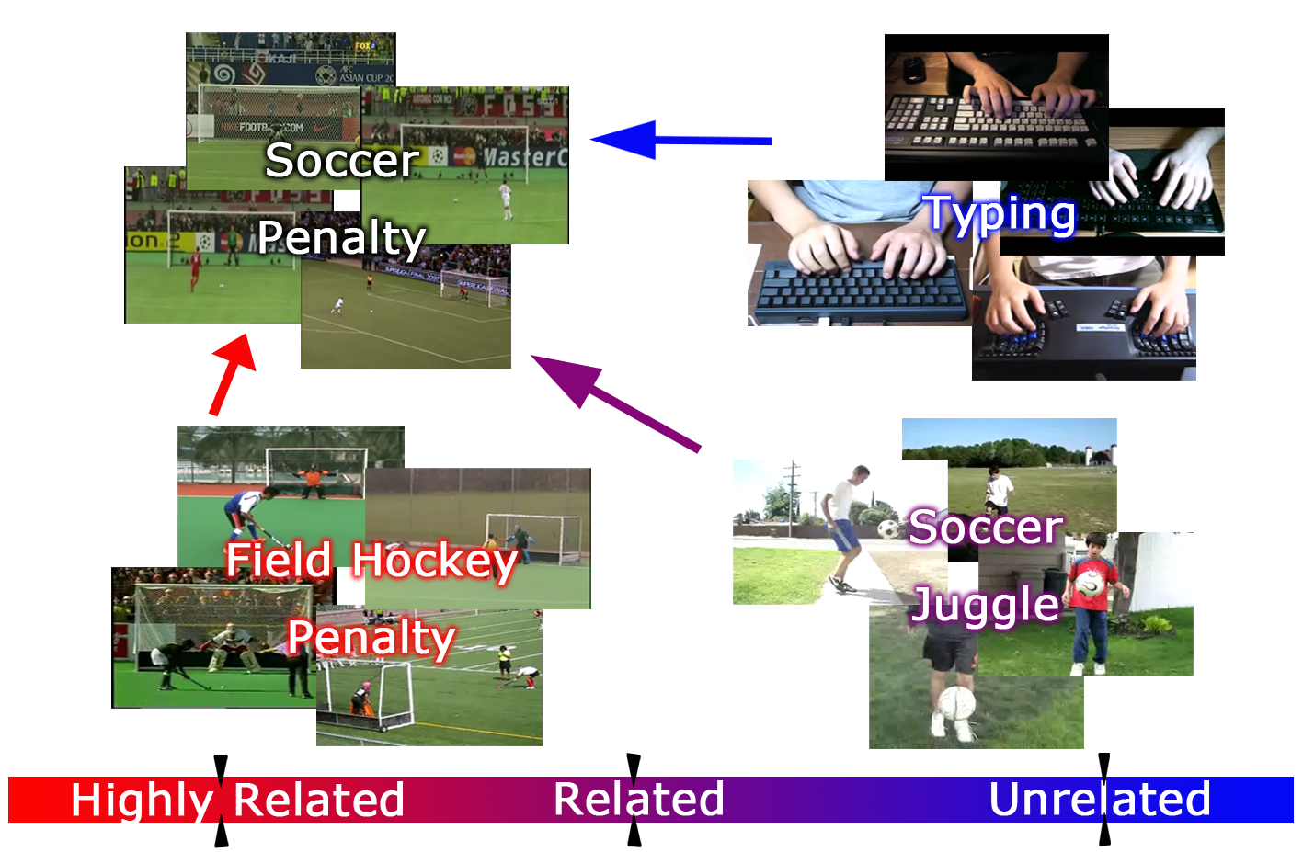
Assumption
  An example of detecting target action soccer penalty

Slide 45
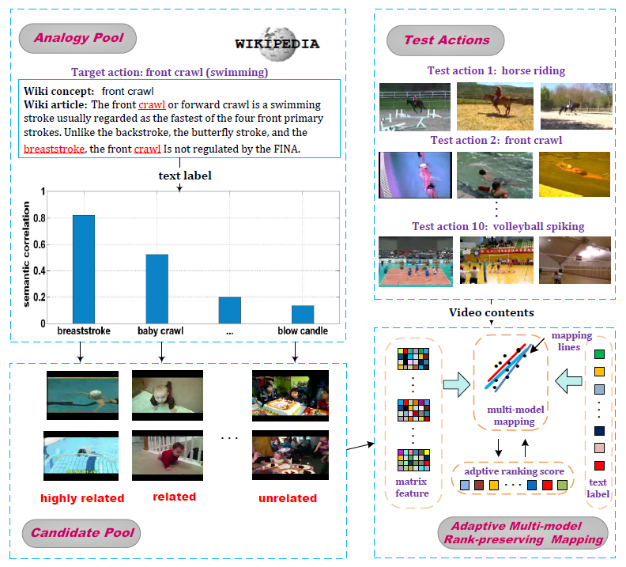
Framework

Slide 46
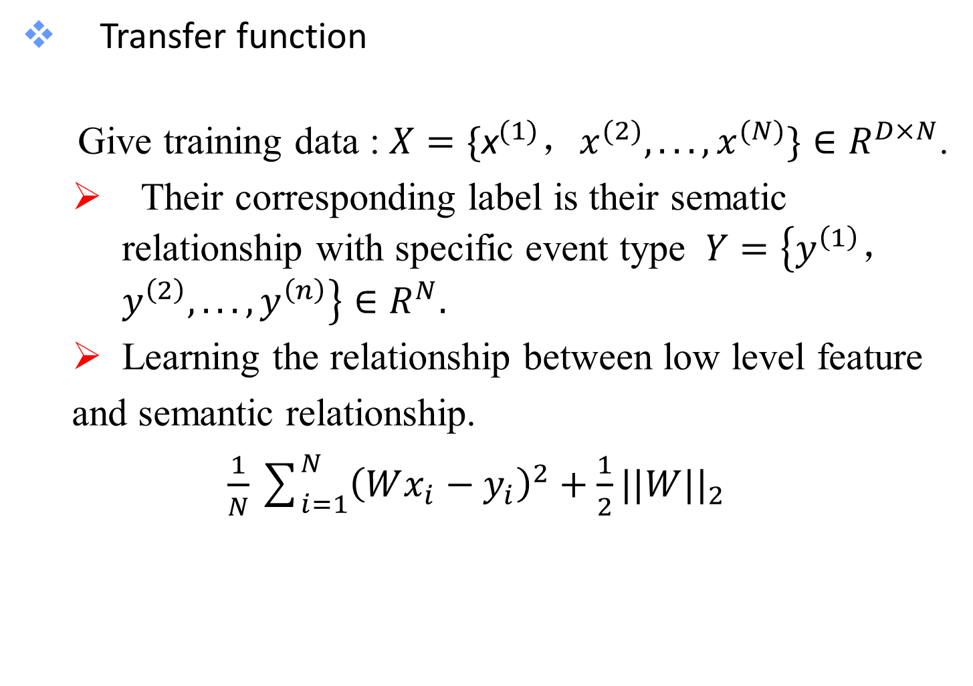
Transfer function
Give training data : $X=\{{\text{x}}^{(1)}，x^{(2)},...,x^{(N)}\}∈R^{D×N}$.
  Their corresponding label is their sematic relationship with specific event type $Y=\left\{y^{\left(1\right)}，y^{\left(2\right)},...,y^{\left(n\right)}\right\}∈R^{N}.$
  Learning the relationship between low level feature
  and semantic relationship.
  $\frac{1}{N}\sum_{i=1}^{N}{{\left(Wx_{i}−y_{i}\right)}^{2}}+\frac{1}{2}||W||_{2}$

Slide 47
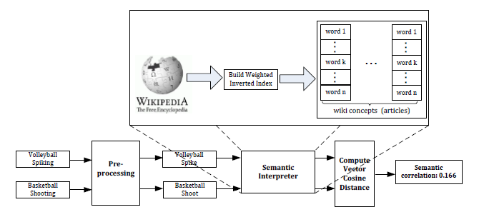
Semantic Correlation

Slide 48
VCD: Visual Concept Discovery
From Parallel Text and Visual Corpora
ICCV 2015
Joint work with Chen Sun, and Ram Nevatia

Slide 49
VCD: Visual Concept Discovery
Motivation: concept detector vocabulary is limited
  Image Net has 15k concepts, but still no “birthday cake”
  LEVAN and NEIL web images to automatically improve the concept detector, but need human to initialize what concepts to be learned.
Goal: automatically discover useful concepts and train detectors for them
Approach: utilize widely available parallel corpora
  A parallel corpus consists of image/video and sentence pairs
  Flickr30k, MS COCO, YouTube2k, VideoStory...

Slide 50
Concept Properties
Desirable properties of the visual concepts
  Learnability: visually discriminative (e.g. “play violin” vs. “play”)
  Compactness: Group concepts which are semantically similar together (e.g. “kick ball” and “play soccer”)
Word/phrase collection by use of NLP techniques
Drop words and phrases if their associated images are not visually discriminative (by cross-validation)
Concept clustering
  Compute the similarity between two words/phrases by text similarity and visual similarity

Slide 51
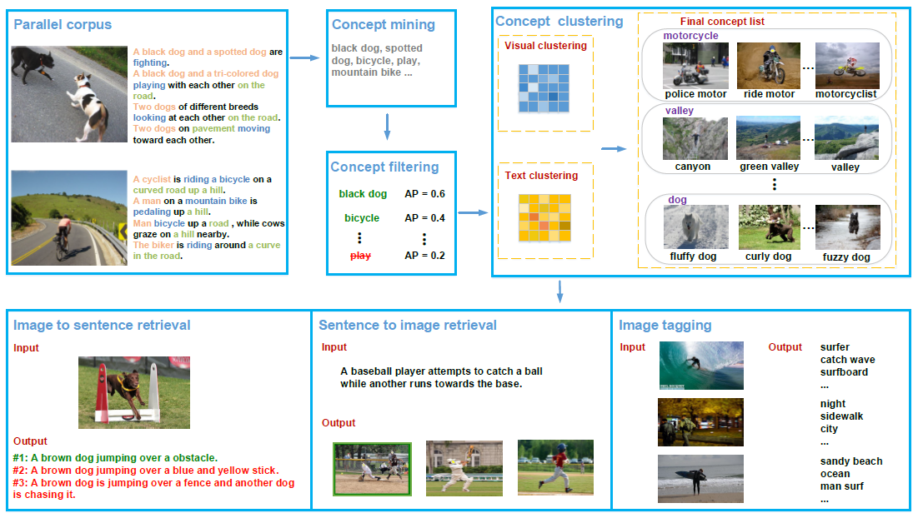
Approach
Given a parallel corpus of images and their descriptions, we first extract unigrams and dependency bigrams from the text data. These terms are filtered with the cross validation average precision. The remaining terms are grouped into concept clusters based on visual and semantic similarity.

Slide 52
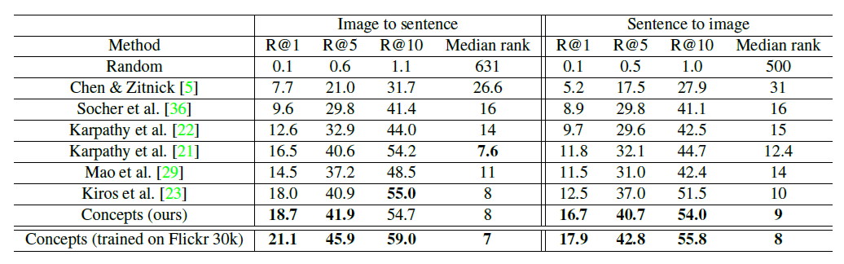
Evaluation
Bidirectional retrieval of images and sentences
  Sentences are mapped into the same concept space using bag-of-words
  Measure cosine similarity between images and sentences in the concept space
  Evaluation on Flickr 8k dataset

Slide 53

Thanks !

