Slide 1
On Computing Compression Trees for Data Collection in Wireless Sensor Networks
Jian Li, Amol Deshpande, Samir Khuller
Department of Computer Science, University of Maryland, College Park, USA
TexPoint fonts used in EMF.
Read the TexPoint manual before you delete this box.: AAAAAAAAAA

Slide 2
Data Collection in WSN
Base Station
1
2
3
4
5

Slide 3
Data Collection in WSN
Base Station
1
2
3
4
5

Slide 4
Data Collection in WSN
Base Station
Cost: 5 bits * 2 hops = 10
1
2
5 bits
3
4
5
Goal: Minimizing communication cost (in bit-hops)

Slide 5
Data Collection in WSN
Naïve Solution:
Every node independently sends its information to BS
Base Station
1
2
Entropy:
3
4
Optimal if all nodes are INDEPENDENT
What if STRONG CORRELATION is present ?
5

Slide 6
Motivation
Sensor networks exhibit very strong correlations
Spatial: Knowing X1 gives us information about X2
Especially true for geographically co-located sensors
Temporal: Knowing X1 gives us information about future value of X1
Intel lab data, 2004

Slide 7
Motivation
Naïve is not optimal any more.
Distributed Source Coding (DSC) Theorem [Slepian & Wolf ’73]
Two isolated sources can compress data as efficiently as though they are communicating with each other.
Can be extended to more than
two sources. [Cover ’75]
Base Station
H(X₁)
H(X₂|X₁)
1
2
H(X₁)
H(X₂)

Slide 8
Motivation
Distributed Source Coding (DSC)
Need to know joint dist. of all nodes (exp. space)
Data cannot deviate from the modeled correlations
Hence, we (1) require explicit communication,
(2) utilize only pairwise correlations
- less space to store
- much easier to learn
Base Station
Compression Trees
H(X₁)
H(X₂|X₁)
✔
1
2
H(X₁)
H(X₂)

Slide 9
DSC Lower Bound
DSC Theorem can be used to derive a lower bound:
Given: X_{i} is closer to BS than X_{i+1}
Base Station
In general, the lower bound is:
1
2
Assume H(X_{i})=h, H(Xi|X_{j})=ε (≈ 0)
Naïve: 9h
DSC: ≈ h
3
4
5

Slide 10
Compression Trees
A directed spanning tree of the network
A node is compressed using its parent
Note: it is not necessarily a subtree of G
Base Station
Base Station
1
1
H(X₁)
H(X₂)
2
H(X₁)
H(X₂)
2
3
4
3
4
H(X₃)
H(X₄)
H(X₃)
H(X₄)
5
5
H(X₅)
H(X₅)

Slide 11
Compression Trees
A directed spanning tree of the network
A node is compressed using its parent
A communication Scheme:
Broadcast model (no receiving cost)
E.g., nodes 1 and 4 broadcast
Base Station
1
2
 | receives | Sends to BS
1 |  | H(X₁)
2 | H(X₄) | H(X₂|X₄)
3 | H(X₁) | H(X₃|X₁)
4 | H(X₁) | H(X₄|X₁)
5 | H(X₄) | H(X₅|X₄)
H(X₁)
H(X₂)
3
4
H(X₃)
H(X₄)
Cost ≈ 2h+8ε
5
H(X₅)

Slide 12
Problem Formulation
Given: G(V,E), H(X_{i}), H(X_{i}|X_{j}) (typically learned from historical data)
Find: a compression tree and a communication scheme
Goal: Minimizing the communication cost (bit-hop metric)
Assumptions
Broadcast model: When a node transmits information, all its neighbors receive it.
Receiving cost at a sensor is negligible compared to sensing cost
Node i can encode X_{i} in H(X_{i}) bits
No node or transmission failures

Slide 13
Our Results
The problem is NP-hard
Approximation algorithms
Uniform Entropies: We show a connection to weakly connected dominating set
General Cases: A generic greedy framework
Simulations

Slide 14
Related Work
Exploit spatial correlation in routing [Patterm et al., 2004]
Data collection in wired networks
Unicast model [[Rickenbach et al., 2004]
Unicast model & uniform entropy, compression tree=routing tree [Cristescu et al., 2006]
Clustering approach [Chu et al. 2006]
Can be seen as a two level compression tree
Nearly optimal for large conditional entropies [Liu et al. 2006]

Slide 15
Uniform Entropies
H(X_{i}) = H(X_{j}) = h, H(X_{i} | X_{j}) = ε
Observations:
Compression tree is a subgraph of the communication graph
For any edge in the tree, either the parent or the child must broadcast
The nodes that locally broadcast their values form a weakly connected dominating set (WCDS)
1
2

Slide 16
Uniform Entropies
H(X_{i}) = H(X_{j}) = h, H(X_{i} | X_{j}) = ε
S is a WCDS if
S is a dominating set (for every v2 V, either v2 S, or v is a neighbor of S)
G-{(x,y), x,y 2 V\S}, is connected
Algorithm: just find a min-cost WCDS
The compression tree is any spanning tree in G-{(x,y), x,y 2 V\S}

Slide 17
Unifrom Entropies
Greedy algorithm for finding a WCDS
Pick the node with highest number of neighbors
Each time: grow the existing tree by picking a node that is:
At most one hop away from an already chosen node
Covers highest number of uncovered nodes
WCDS hard to approximate within lnΔ , where Δ is the max. degree
Has approximation ratio of:
where d_{avg} is the average distance to BS
≈ lnΔ if ε is very small
Better if ε is large (i.e., weaker correlations)

Slide 18
Greedy Framework
We maintain a forest (Initially, each node is a singleton tree )
In each iteration, connect a few trees by the most cost-effective treestar

Slide 19
Greedy Framework
We maintain a forest (Initially, each node is a singleton tree )
In each iteration, connect a few trees by the most cost-effective treestar
where c(r,{v_{j}}_{j2 S}) is the minimum cost for sending X_{r} from r to all v_{j}'s
r

Slide 20
Greedy Framework
We maintain a forest (Initially, each node is a singleton tree )
In each iteration, connect a few trees by the most cost-effective treestar
where c(r,{v_{j}}_{j2 S}) is the minimum cost for sending X_{r} from r to all v_{j}'s
r

Slide 21
Greedy Framework
It is an O( α log n)-approx. where α is the approx. ratio for computing most cost-effective treestar
Compression tree is a subgraph of G: O(log n)-approx.
Compression tree is not necessarily a subgraph of G:
O(n^{ε} log n)-approx. (since α=O(n^{ε}) )
Can be extended to wired networks
The results generalize Cristescu et al.’s results [2006]

Slide 22
Greedy Framework-Subgraph
In each iteration, pick the most cost-effective treestar
A treestar is a star in G

Slide 23
Greedy Framework-Subgraph
In each iteration, pick the most cost-effective treestar
A treestar is a star in G
We can compute the most cost-effective treestar in Polynomial time
4
1
2
3

Slide 24
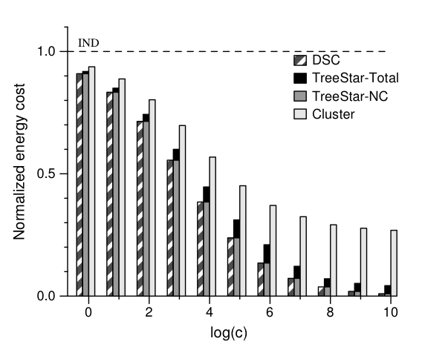
Simulations
Synthetic dataset generated using a model learned from observed rainfall data in Northwest region [Pattem et al., 2004]
dist(i,j): Euclidean distance
c: parameter that controls correlation.
larger c , stronger correlation
IND: Naïve solution;
Cluster: [Chu et al. 2006] ;
NC: conditional information sent to BS

Slide 25
Future Directions
Extension to higher order correlations
Distributed algorithms
Better approximations for unit disk graphs
Dealing with failures (node or transmission failures)

